Slide 1

ADVANCING THE LABORATORY PROFESSION AND NETWORKS IN AFRICA
Strengthening Laboratory Systems for HIV Differentiated Service Delivery
Anafi Mataka
African Society for Laboratory Medicine
AIDS 2018

Slide 2
Outline
The role of the laboratory in scaling up DSD
Strengthening lab systems to improve the coverage and utilization of HIV viral load testing
Introduction to the LabCop learning network

Slide 3
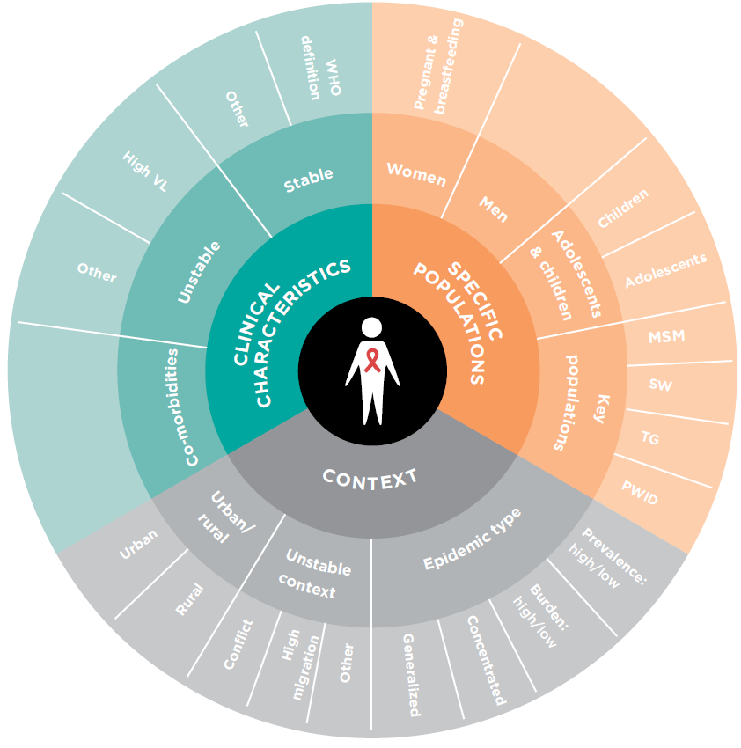

Lab testing is needed to “differentiate” patients
Most DSD guidelines recommend viral load and/or CD4 testing to identify “stable” vs. “unstable” patients
Other lab tests also critical:
CrAg
TB diagnostics
Biochemistry
Hematology
Bacteriology
Pregnancy test
Syphilis and other STIs

Slide 4
Viral Load testing is often the gateway to DSD for stable patients

Slide 5
Outline
The role of the laboratory in scaling up DSD
Strengthening laboratory systems to improve the coverage and utilization of HIV viral load testing
Introduction to the LabCop learning network

Slide 6

At country level: Viral Load testing coverage is not sufficient to achieve the 3rd 90
Scale-up of Viral Load testing in 7 PEPFAR-supported countries
Lecher et al. MMWR 2016
Countries | % gap between targets and actual needs | # of HIV patients in 2015 | % increase of patient in 2016 | % ART patients with ≥1 VL test | % VL test with Viral suppression
Côte d’Ivoire | 36% | 147,947 | 8% | 11 | 66
Kenya | No gap | 860,297 | 7% | 49 | 84
Malawi | 61% | 595,186 | 2% | 19 | 89
Namibia | No gap | 143,805 | 3.5% | 43 | 87
South Africa | No gap | 3,318,384 | 3% | 91 | 83
Tanzania | 74% | 758,344 | 1.5% | 9 | 72
Uganda | 33% | 1,066,519 | 9% | 22 | 92
…but some countries do better than the others.

Slide 7
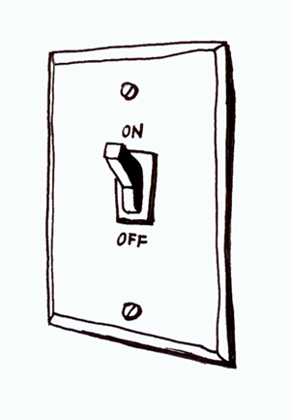
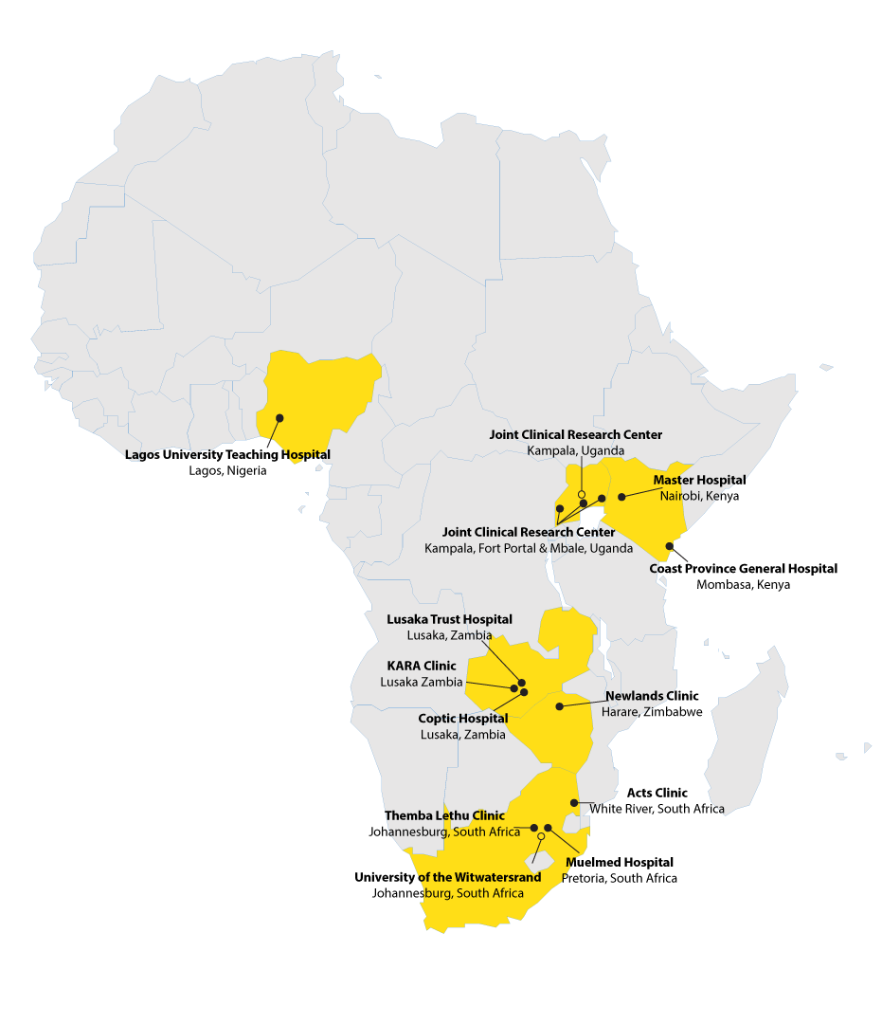

At clinic level: access to VL does not always translate into improved switch practices
Aim: Compare the appropriateness and timeliness of switch to 2nd or 3rd line ART regimen, across clinics with full/phasing in/no access to VL testing
13 clinics in 6 countries
First line
Follow up between 2008-2015
Different level of access to VL testing
2420 patients with ≥ 2 VL results
266 confirmed virological failures
(2 consecutive VL>1000 RNA copies)
Second-line
VL result
N=266 | Full access to VL | Access to VL phasing in | No access to VL
Switch | 61 (37%) | 16 (25%) | 14(39%)
Same regimen | 105 (63%) | 48(75%) | 22(61%)
Ondoa, Kim, Boender, et al (in preparation)

Slide 8

Systems issues affecting the Viral Load testing cascades
Patient cohort
Facility visit
Sample collection
Sample transport
Test performed
Result returned
Clinical consultation
Clinical action
0
1
2
3
4
5
6
7
Policy & regulation
Sample referral
system
Q^{ty} management systems
Supply chain
Laboratory
Clinic interface
Workforce
Poor demand from patients and clinicians
HIV care services are overloaded
Lack of SOP
Issues with sample conservation
Sample referral system with
  low coverage
  no tracking system
Long turn around time of sample transport
Poorly optimized work flow
Shortage of human resources
Insufficient testing capacity
Insufficient Quality
Reagent stock out
Equipment maintenance
Long turn around time
Ineffective laboratory clinic interface
Lack of or poor compliance to guidelines to use results
Lack of differentiated care models
Stock out of ARVs

Slide 9
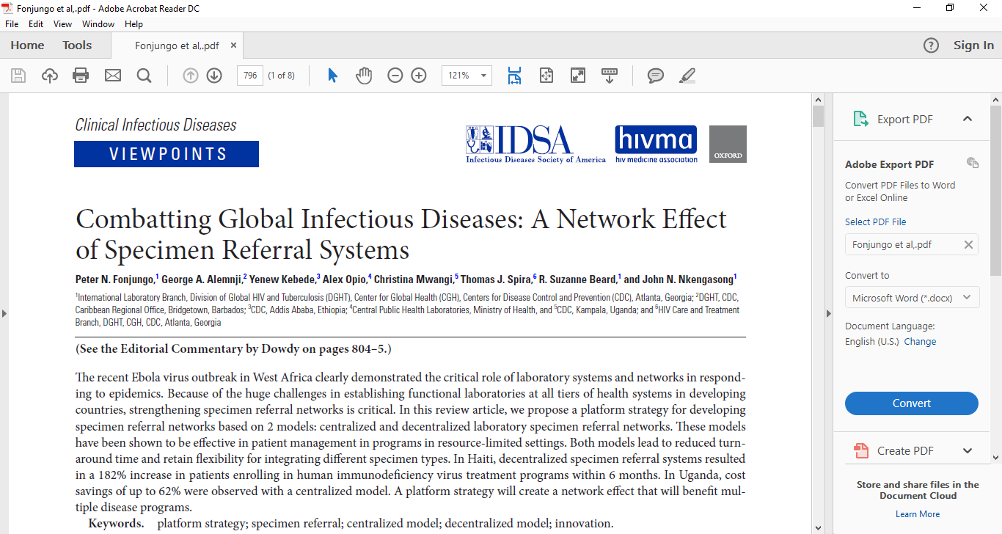

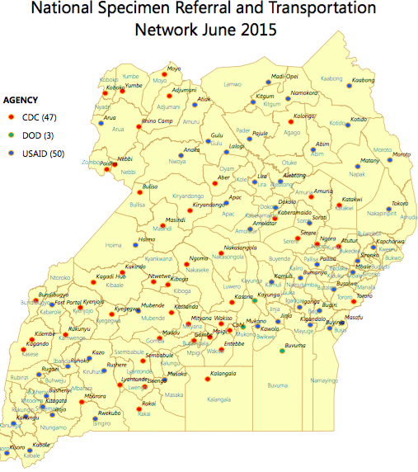
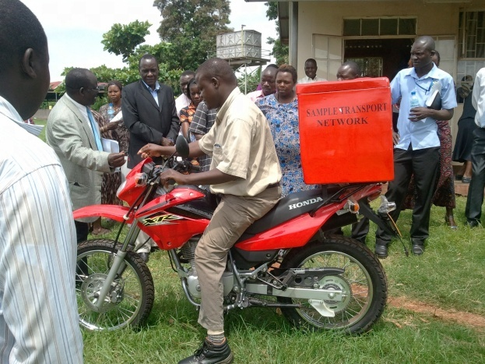


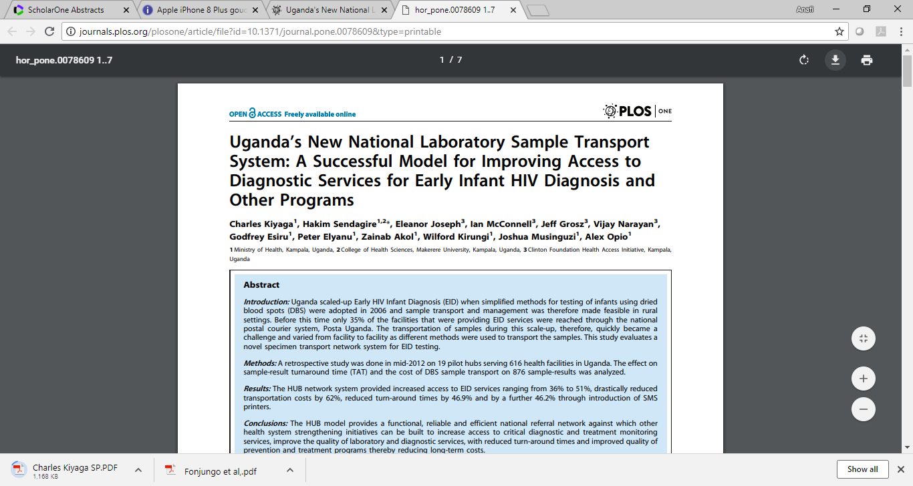
A good sample referral system increases the testing coverage of the laboratory network –
GIS-mapping of facilities and road network a 30 to 40km radius around the hub
Haiti ~182% ART
Enrolment in 6 m
Fonjungo et al, 2017
100 hubs reaching 2500 to 3000 health facilities
~90% coverage
~62 % cost savings
Rider reaches each of the 20 to 30 health facilities under the hub catchment at least once a week,
At each visit:
  samples pick up
  results drop off
Model and best practices exported to Sierra Leone
Charles Kiyaga|ASLM

Slide 10
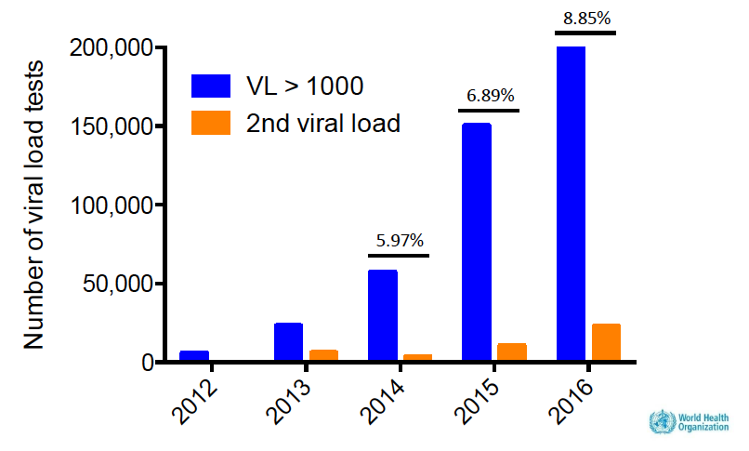
Improving VL test results utilization
Approximately 50% of CD4 tests and EID tests performed in SSA were never used [Peter et al. JIAS 2017]
Early warning signs for VL utilization:
In a national review from Kenya: only 4.1% of patients with unsuppressed VL (UVL) had a repeat VL test; only 1.6% of these occurred within 4 months [Mwau et al. PLoS One 2017]
In a retrospective cohort study in Mozambique, 35% of patients with UVL had a repeat VL test [Swannet et al. Int Health 2017]
Lara Vojnov WHO. Regional Viral load meeting October 2017

Slide 11




What are the barriers to VL utilization?
What works?
Identifying unsuppressed Viral Load (UVL)
  Systematically connecting results to patients – getting data into a chart or register
  Flagging as an emergency
Acting on the results
  Identifying a responsible individual
  Incentivizing urgent action
  Contacting/recalling patients
Supporting patient engagement
  Counseling
  Transportation support
  Demand creation
  Supporting patient engagement
Experience from Quality Improvement interventions in Kenya
VL focal persons / champions
UVL management standard operating protocols (SOPs)
Immediate (daily) review of VL results
UVL registers
Stickers on charts / color-coded files
Standardized EAC strategies and tools
Case managers

Slide 12



Point of care VL to simplify the VL testing cascade
Continuum of Care
Patient cohort
Facility visit
Sample collection
Sample transport
Test performed
Result returned
Clinical consultation
Clinical action
0
1
2
3
4
5
6
7
By condensing into a single visit, POC has the potential to eliminate
Loss points between sample collection and test performed
Loss points between tests performed and result return
Loss points between result return and clinical action

Slide 13
Mitigating barriers to the uptake of POC technology:
example of a UNITAID project
Outputs
Workstreams
1. POC product approval
Technical evaluations
WHO PQ or SRA, CDC endorsement
In-country registration
2. Routine POC testing established
Patient impact
Operationalization
Site selection & network optimization
Uptake
3. Systems & Conventional strengthening
Demand generation
Sample transport
Data management systems
Supply chain
Linkage to care & retention
4. Global access pricing
Improved service terms
Sustainable pricing
Integrated pricing
Harmonized contracts across buyers
5. Catalytic procurement
Commodity procurement
6. Co-investment
WHO guideline recommendations
GF grants and PEPFAR COP
Adoption in other countries
Courtesy of Dr Trevor Peter- CHAI

Slide 14
Sharing good ideas & best practices: how?
Some countries have found ‘better ideas’ to scale up viral load testing and to strengthen Laboratory systems,
How can best practices, innovations and implementation solutions be identified, disseminated from one country to others and adopted?
Notes:
Added the publication images from slide 9

Slide 15
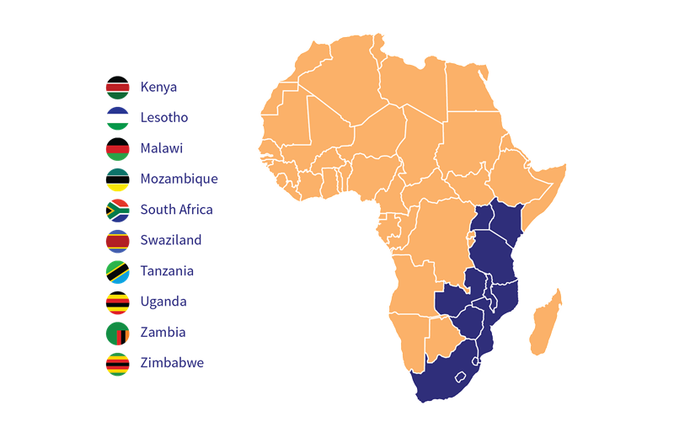

How can less funded countries benefit from advancements made in VL scale up?
How do improvements along the viral load cascade benefit other diseases?
How to bring all stakeholders in the discussion?
HIV
STI
NCD
EID
TB, Mal,
Laboratory nerds
?
Program managers
clinicians
Civil society
Policy makers
DOZENS OF COUNTRIES LEFT OUT OF NEW PEPFAR STRATEGY, THREATENING THE GLOBAL AIDS RESPONSE
Plan Reflects Significant Resource Scarcity, Congress & Administration Failure to Provide Sufficient Funding
Implementing partners
How Flexible is the Lab in the face of DSD models?

Slide 16
Outline
The role of the laboratory in scaling up DSD
Strengthening laboratory systems to improve the coverage and utilization of HIV viral load testing
Introduction to the LabCop learning network

Slide 17



The laboratory system strengthening Community of Practice
A Bill & Melinda Gates funded platform:
For exchange and discussion between multiple countries and stakeholders
For the fast track identification, dissemination and adoption of ‘better ideas’
to improve laboratory system functions and accelerate the scale-up of HIV Viral Load testing for improved patient management
Supported by the Bill & Melinda Gates foundation

Slide 18
11 countries participate in LabCoP, so far
Ethiopia,
Kenya
Uganda
Tanzania
Malawi
Zambia,
Zimbabwe
Sierra Leone
South Africa
DRC
South Soudan
Participants Country Teams – mix of stakeholders and disciplines to take different perspectives into account
  Laboratory
  Policy makers
  Clinicians
  Civil Society
  Development and Implementing partners
Methods : interactive, online seminars (ECHO model) completed by individualized country follow-up and bi-annual face-to-face meetings
Focus areas prioritized based on:
  Feasibility of behavior change
  Multidisciplinarity of discussion
  Opportunity for developing action plans

Slide 19

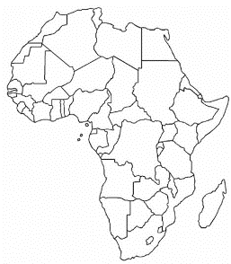

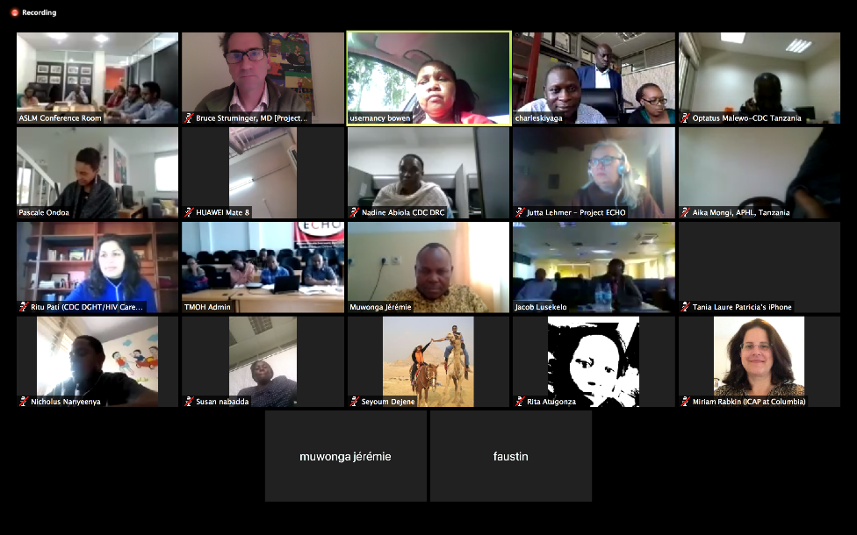

Country visits
Virtual ECHO sessions
VL testing cascade assessment
Identification, dissemination & adoption of best practices
Accelerate VL scale up and Strengthen Laboratory systems

Slide 20

LabCop shares ‘recipes’ as opposed to ‘menus’
Countries are not offered a chocolate cake on the menu
They are taught to cook the chocolate cake

Slide 21

Thank you

